Slide 1
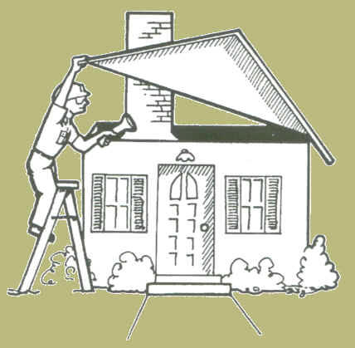
HQS Inspection Basics
Electrical Hazards
Window Conditions
Sinks
Smoke/Carbon Monoxide Detectors
Interior and Exterior Hazards
Stairs
Stove/Oven
Bathrooms
Water Heaters
Lead Based Paint

Slide 2
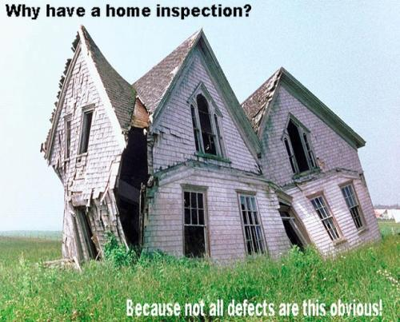

Slide 3
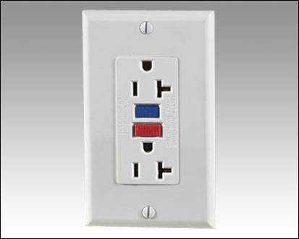
#1 Electrical Hazards
Causes of failure
OUTLETS
Loose/cracked covers
Inoperable GFCI test buttons
Improperly wired
Inoperable
OTHER
Missing light globes
Open junction boxes
Overloaded power strips
Extension cables on garage door opener
Open slots in circuit panel
Missing garbage disposal stress clamps

Slide 4
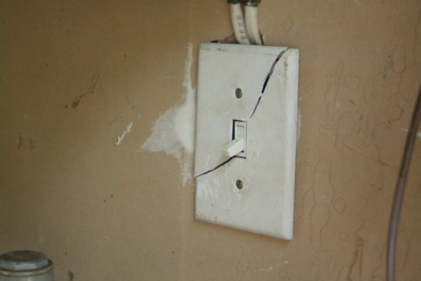
Fail

Slide 5
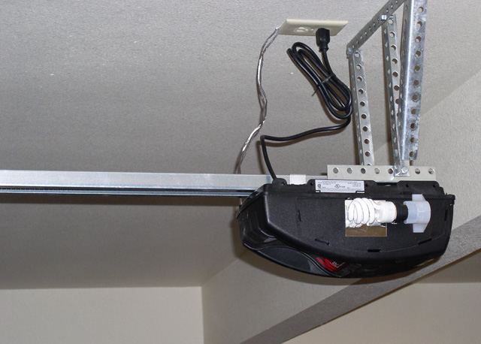
Pass

Slide 6
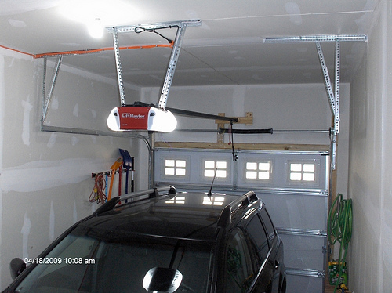
Fail
Garage Door requires wired outlet

Slide 7
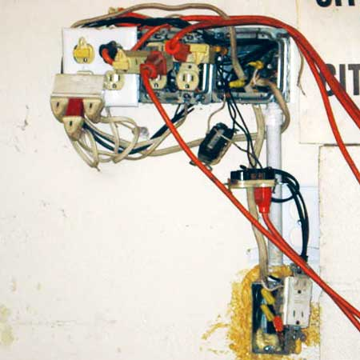
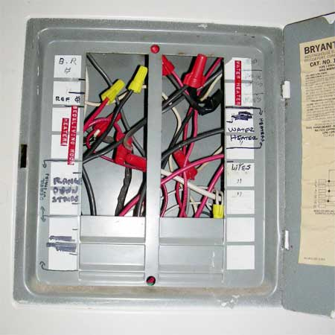
Fail

Slide 8
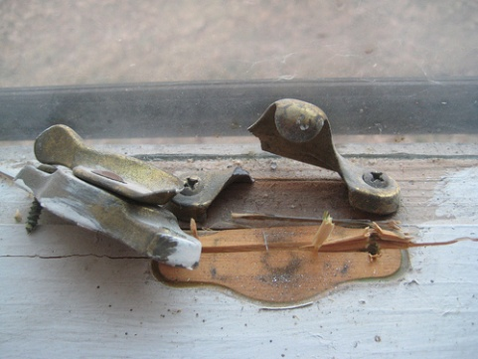
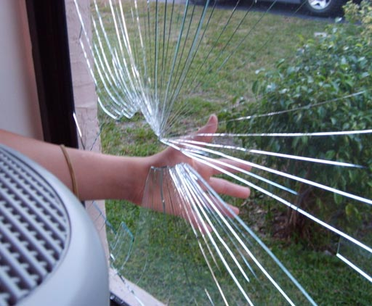
#2 Window Conditions
Causes of failure
Missing or torn screens
Broken locks (first floor windows)
Broken/cracked panes
Windows that won’t open or don’t stay open
Broken handles
Excessive air infiltration

Slide 9
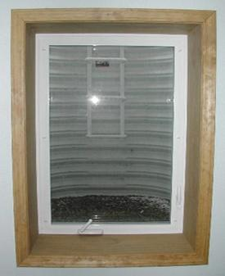
Pass
Egress windows are required in basement rooms if used for sleeping.

Slide 10
Fail

Slide 11
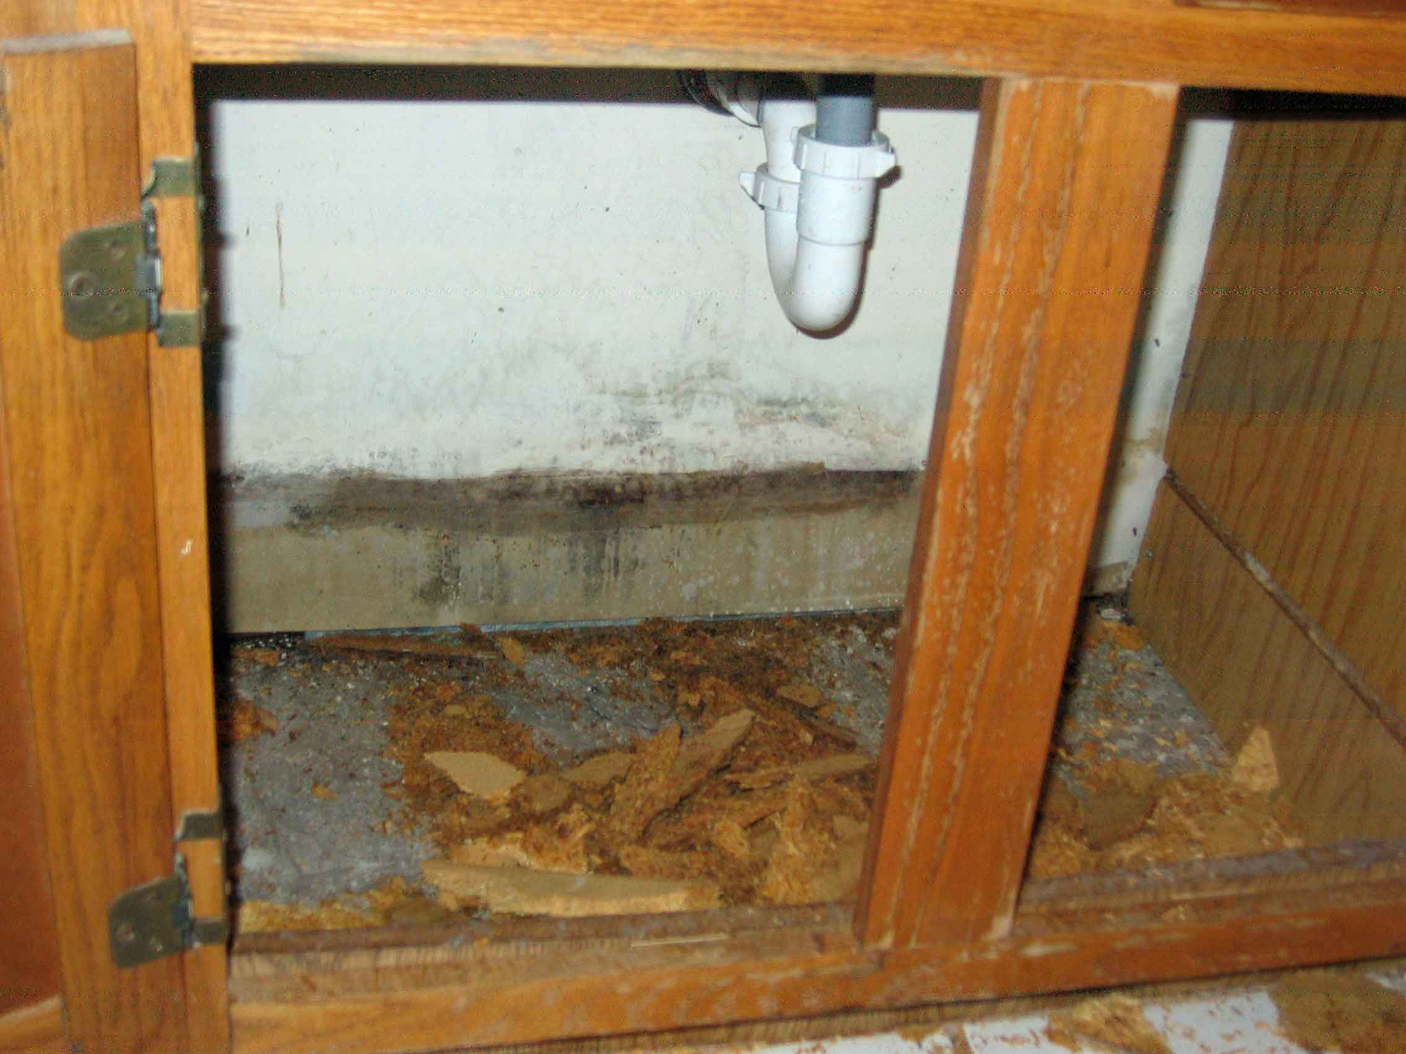
#3 Sinks
Causes of failure
Leaky drain pipes
Loose faucets
Water damage in base cabinets
Missing/improper p-traps

Slide 12
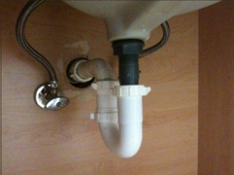
Pass

Slide 13
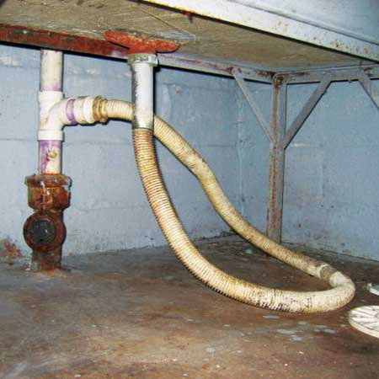
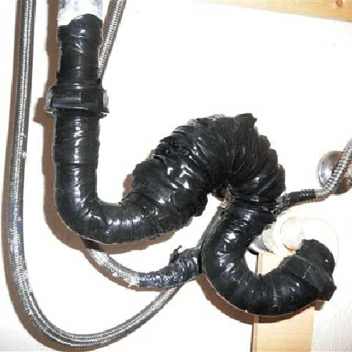
Fail

Slide 14
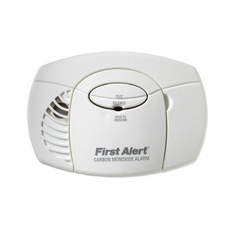
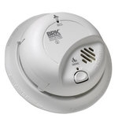
#4 Smoke/Carbon Monoxide Alarms
HQS Requirements
One smoke alarm is required in a common area on every level
C/O alarms must be within 10 feet of every bedroom
Hearing impaired tenants require a special strobe light smoke alarm that is linked from sleeping rooms to a common area.
Causes of failure
Inoperable alarms
Hanging or missing alarms
Low battery signals (Chirping)
Smoke alarms located too close to walls

Slide 15
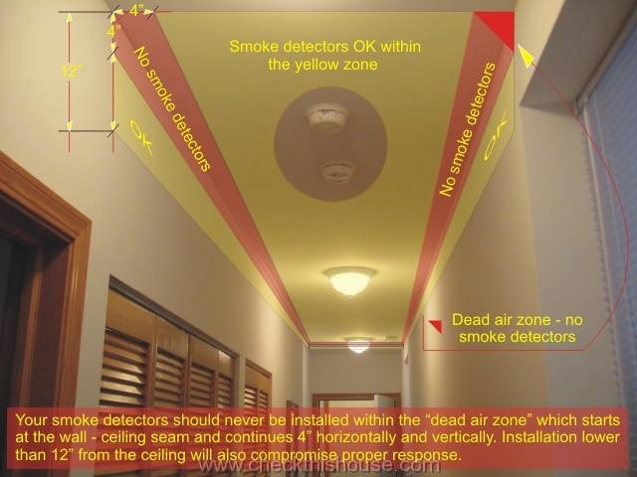
Pass

Slide 16
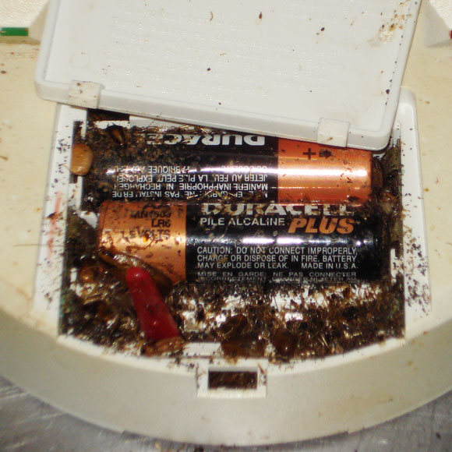
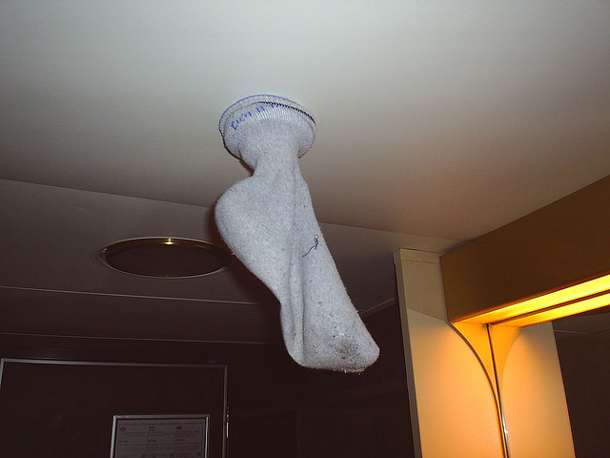
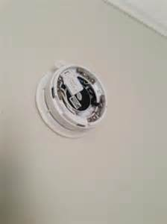
Fail

Slide 17
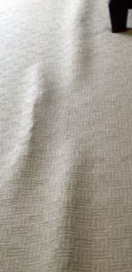
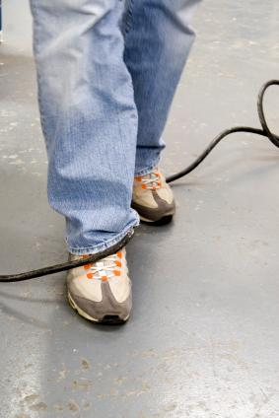
#5 Interior/Exterior Hazards
Interior hazards come in a variety of different forms
Tripping Hazards
Worn Carpet
TV Cables
Missing carpet bars
Other
Blocked Exits
Sharp objects
Unstable fences

Slide 18
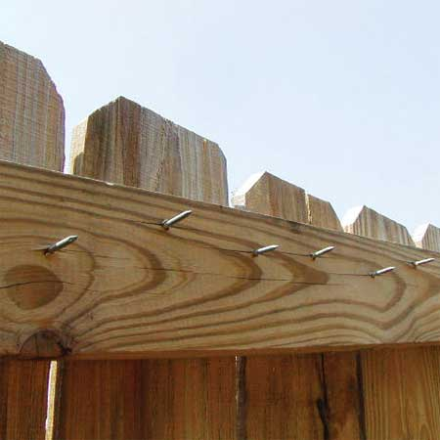
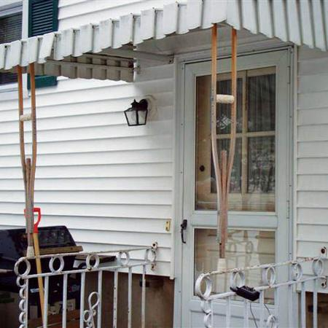
Fail

Slide 19
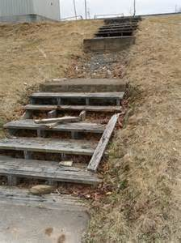
#6 Stairs
No Loose, broken, or missing steps
Handrails are required on sections of stairs with four or more consecutive steps
A railing is required for areas with a drop off of more than 30 inches.

Slide 20
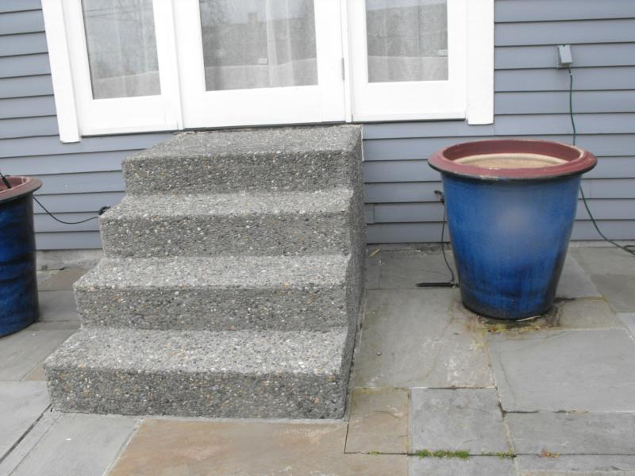
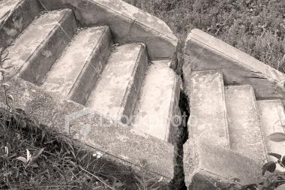
Fail

Slide 21
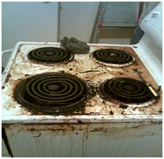
#7 Stove/Oven
Causes of Failure
Inoperable burners
Excessive debris around or underneath burners
Missing drip pans
Missing knob and handles
Missing oven gasket

Slide 22
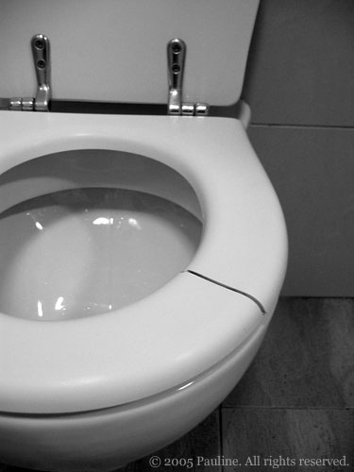
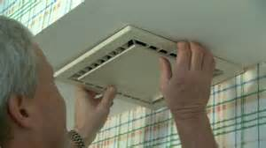
#8 Bathrooms
Causes for failure
Excessive mold
Missing shower tiles
Clogged drains
Wobbly Toilets
Broken toilet seats and covers
Inoperable vent fans

Slide 23
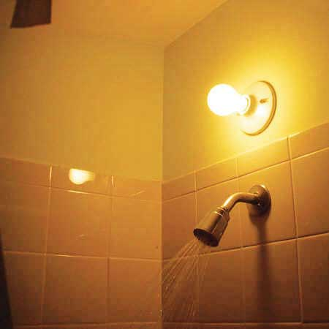
Fail

Slide 24
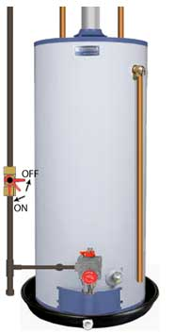
#9 Water Heaters
Temperature and pressure valve
T&P relief valve
T&P Relief Tube
Exhaust tube must be secured to tank and must have constant positive slope.
Base cover must be in place

Slide 25
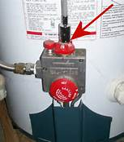
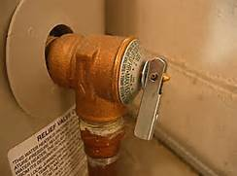
#9 Water Heaters

Slide 26
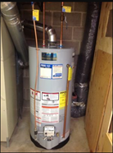
Pass

Slide 27
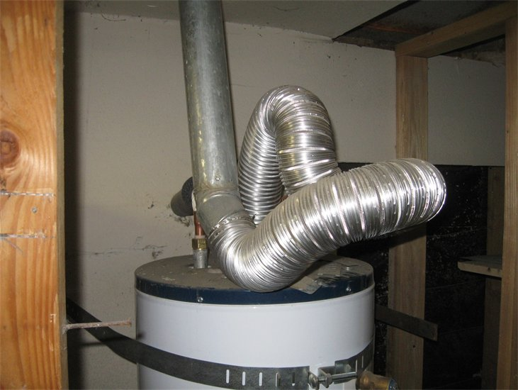
Fail

Slide 28
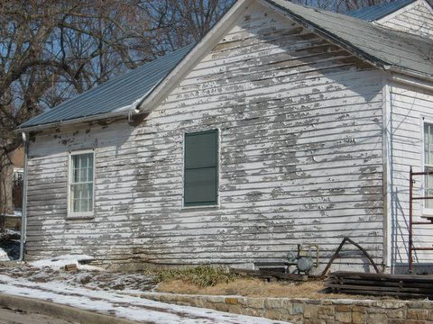
#10 Lead Based Paint
All homes built prior to 1978 inhabited by children under the age of 6 will be checked for chipping and peeling paint.
Lead was a common ingredient in paint until 1978.
Paint ingested by children can cause brain damage.

Slide 29
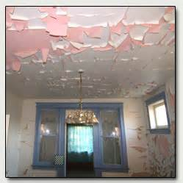
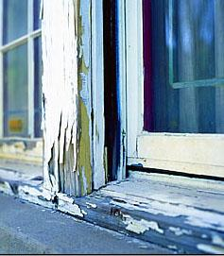
#10 Lead Based Paint

Slide 30
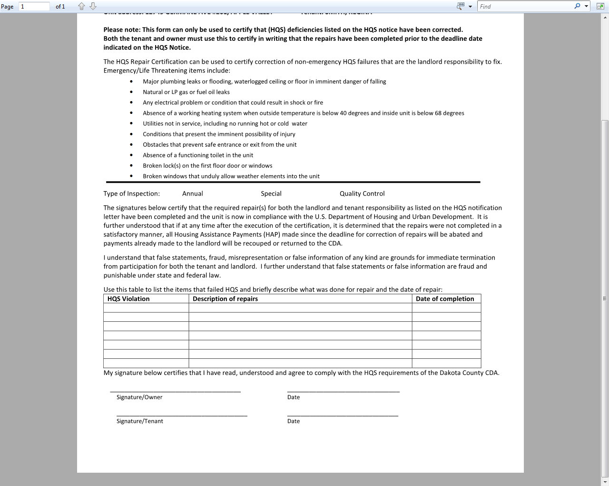
Repair Certifications
Can be used to certify correction of non-emergency HQS failures

Slide 31
QUESTIONS?

